Slide 1

John Evans Okyere Data Analyst Presenting on world happiness Data Source: Sustainable Development Solutions Network 20-03-2024

Slide 2

World Happiness
Purpose Statement(world happiness)
Visualization
Conclusion
Data Story telling
Appendix

Slide 3

About Me
I am self taught data analyst with a degree in computer science and some projects in Python, Excel, MySQL, Tableau and Power BI

Slide 4
Objectives
Identify if there are geographic, demographic, and / or economic factors that contribute to a happier life

Slide 5
Data benefits
Analyzing World Happiness data is crucial for understanding global well-being trends, informing policies, promoting social progress, evaluating quality of life, comparing across regions, understanding cultural differences, and promoting mental health

Slide 6
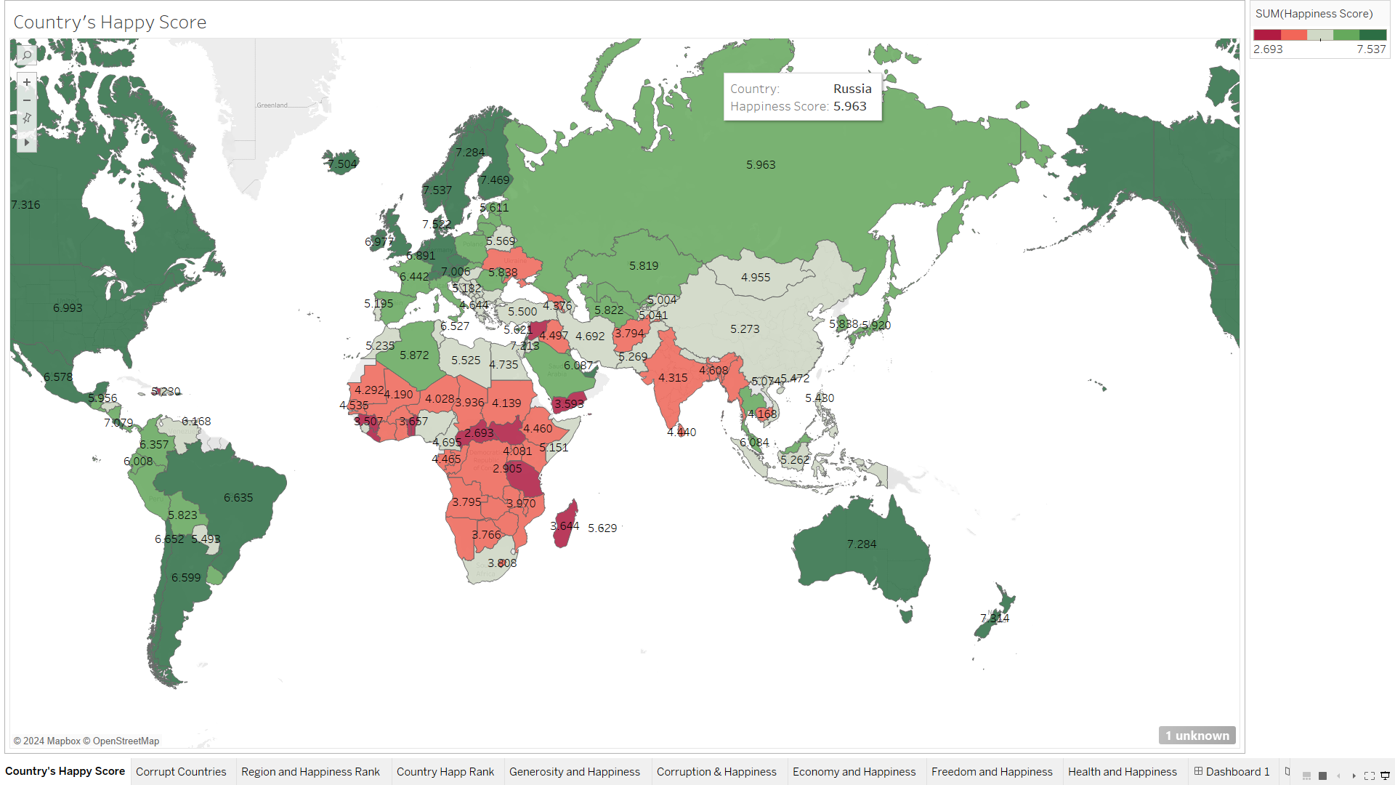
Geographic 1.The deep green portion are the county’s with high happiness score 2. The portion colored red are the countries with less happiness rate 3. Happiness levels vary widely by country 4. Little correlation between geographical location and happiness 5. Geographical location is not a strong indicator of happiness

Slide 7
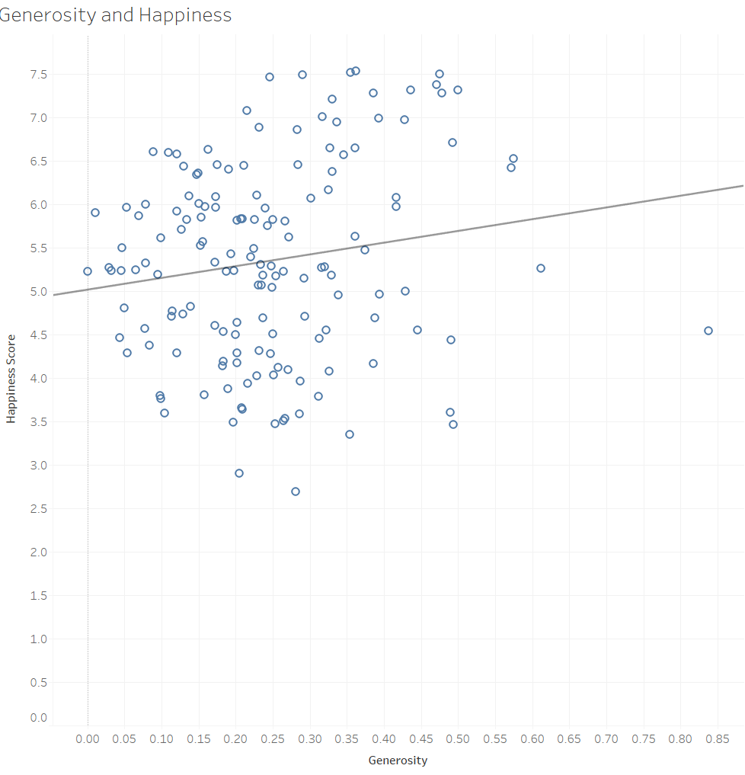
Generosity vs Happiness The analysis suggests a statistically significant but weak positive relationship between Generosity and Happiness Score. The countries with higher levels of Generosity tend to have slightly higher Happiness Scores on average. Countries with average levels of generosity demonstrate a diverse range of happiness scores, encompassing both high and low values.

Slide 8
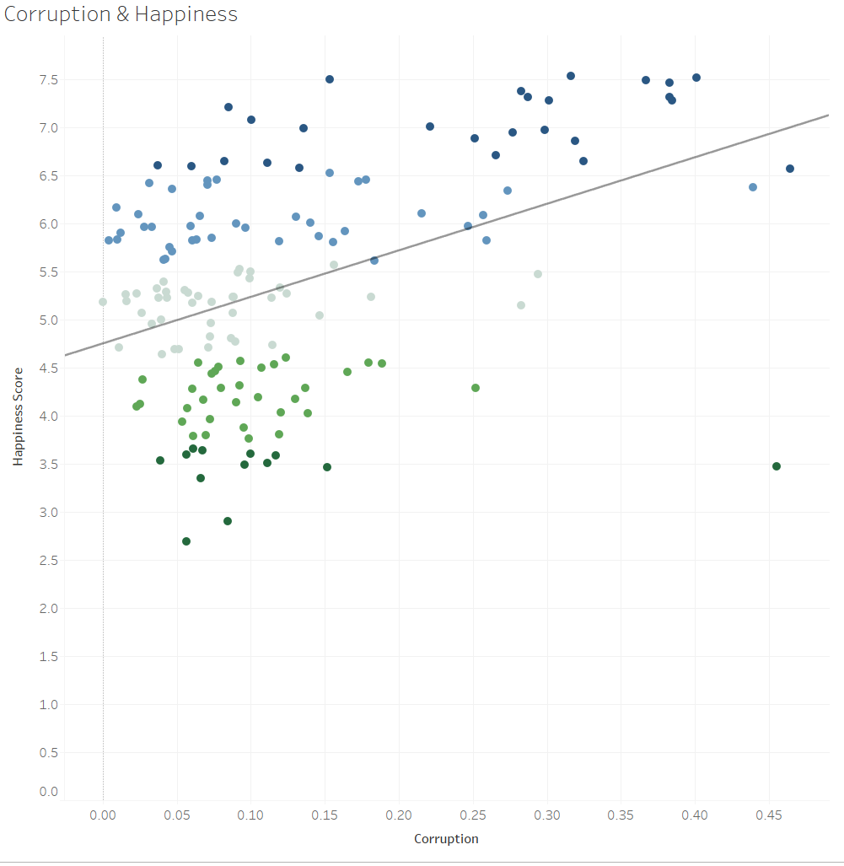
Corruption vs Happiness The relationship between corruption and happiness may not be linear. The happiness score seems to level off or even and then slightly increase at the higher end of the corruption scale (lower corruption). Countries with high corruption levels may exhibit high happiness rates, surpassing nations with lower corruption levels. This suggests that factors beyond corruption, such as economic prosperity and social support systems, significantly influence happiness levels. Understanding this nuanced interplay is essential for addressing happiness disparities among nations.

Slide 9
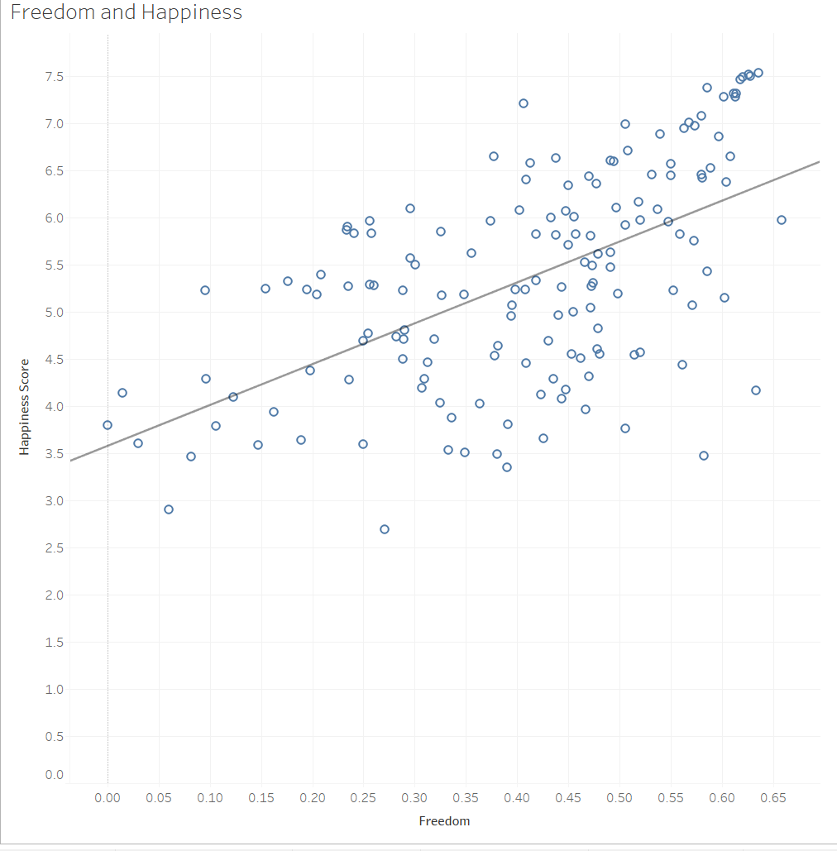
Freedom and Happiness suggests a robust relationship between Freedom and Happiness Score. This indicates that Freedom has a considerable impact on the overall happiness levels of countries. countries with greater levels of freedom tend to report higher Happiness Scores. This suggests that political, social, and economic freedoms contribute positively to the well-being and happiness of individuals within a society.

Slide 10
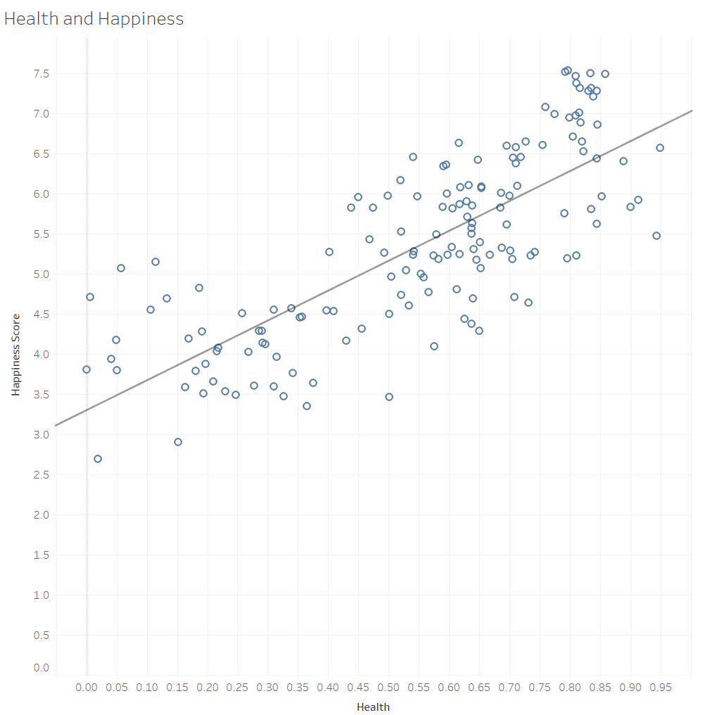
Health vs Happiness Indicate a robust and positive relationship between health and happiness score. This suggests that countries with higher levels of good health tend to have higher happiness scores. The model's strong explanatory power implies that health is a significant predictor of happiness score. Countries with better health outcomes are more likely to report higher levels of happiness among their populations.

Slide 11
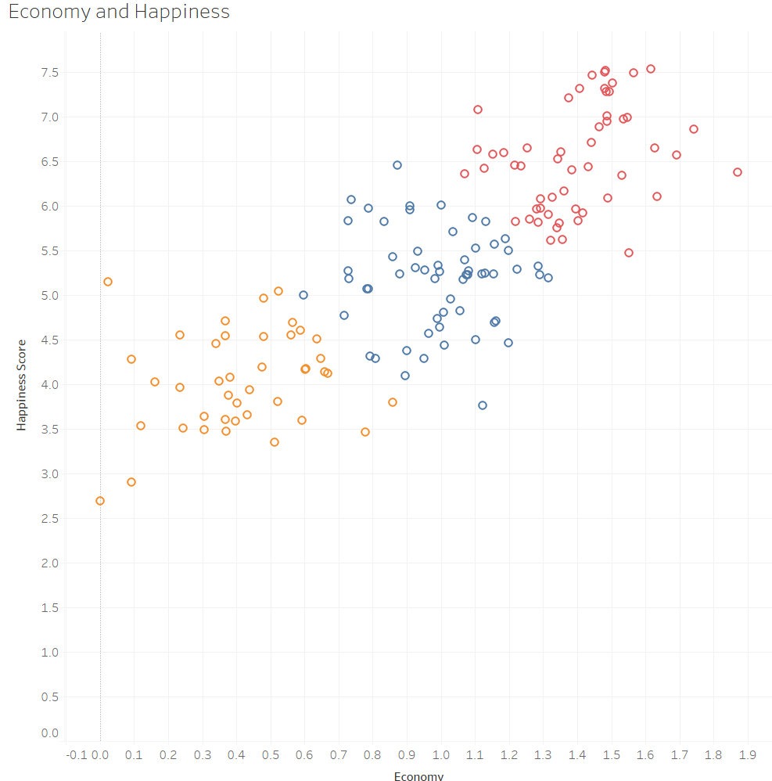
Economy and Happiness The country clusters suggest that there is a positive association between economic prosperity and happiness levels. Within the first cluster, countries with lower GDPs tend to display lower happiness rates. Conversely, the third cluster, characterized by higher GDPs, exhibits higher happiness rates. This observation reinforces the conventional wisdom that countries with stronger economies generally report higher levels of happiness, a notion neither surprising nor shameful

Slide 12
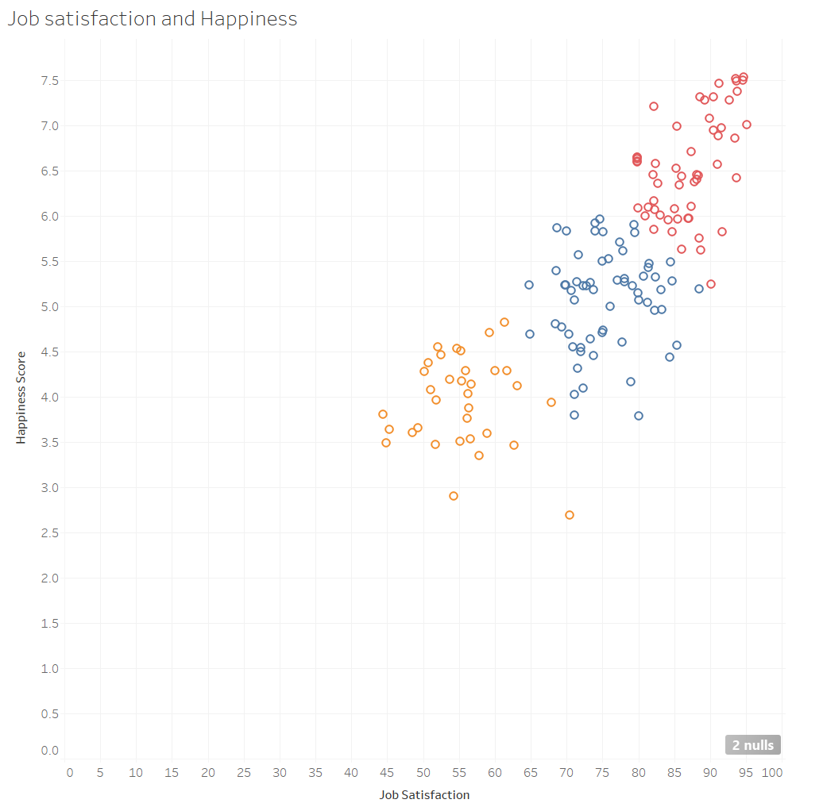
Job Satisfaction vs Happiness Clusters highlight a robust connection between job satisfaction and happiness scores. Cluster 3 notably represents nations with high job satisfaction levels, closely aligning with elevated happiness rates. Cluster 3 showcases countries where job satisfaction is prominent, paralleled by notably high happiness rates, underscoring the vital relationship between workplace contentment and societal well-being. Conversely, countries with lower job satisfaction often exhibit lower happiness rates, revealing the significant impact of job dissatisfaction on national happiness levels.

Slide 13
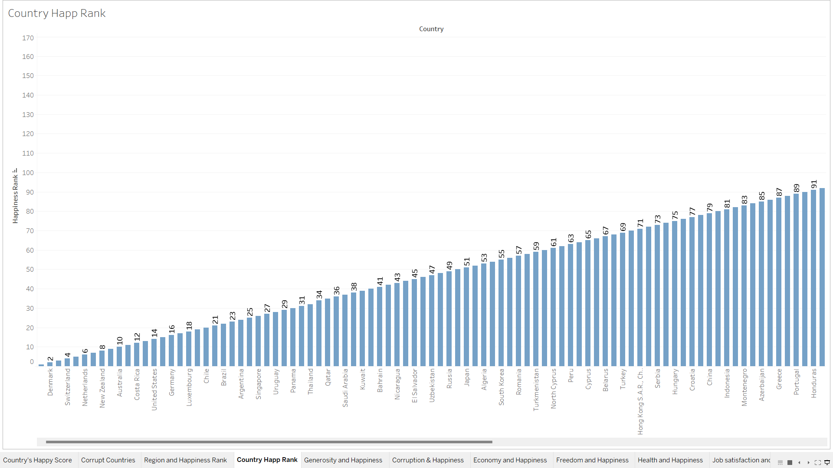
Country vs Happiness A country's happiness score is influenced by a variety of factors including GDP, health, job satisfaction, and freedom. These elements collectively contribute to the overall well-being and contentment within a nation, underscoring the importance of addressing diverse dimensions of happiness for societal prosperity.

Slide 14



CONCLUSION
1. In conclusion, the analysis reveals complex relationships between various factors and happiness scores. While generosity, freedom, health, and economic prosperity positively influence happiness, their impact varies across nations.
2. Interestingly, corruption may not have a straightforward relationship with happiness, as some countries with high corruption levels still exhibit high happiness rates. Understanding these nuanced dynamics is essential for addressing happiness disparities among nations
3. Overall, fostering economic prosperity, social support systems, and individual well-being is crucial for promoting happiness worldwide

Slide 15
WORLD HAPPINESS STORY TELLING Once upon a time, a diligent data analyst embarked on a quest to uncover the secrets of happiness across diverse nations. They discovered that while generosity influenced happiness positively, its impact varied. Surprisingly, some nations with high corruption levels still boasted remarkable happiness rates, hinting at the influence of factors beyond corruption. Freedom emerged as a key determinant, with nations enjoying greater freedoms reporting higher happiness scores. Additionally, better health outcomes and economic prosperity were linked to higher happiness levels. Job satisfaction also played a crucial role in happiness. In conclusion, happiness was a multifaceted tapestry woven from generosity, freedom, health, prosperity, and job satisfaction, showcasing the interconnectedness of factors shaping societal well-being.

Slide 16

Thank you
John Evans Okyere
https://github.com/JohnEvansOkyere
https://www.linkedin.com/feed/

